Slide 1
DEPTH FIRST SEARCH (DFS)
Group Members:
Abdul Ahad Shaikh (20K-0319)
Basil Ali Khan (20K-0477)
Syed Ali Jodat (20K-0155)

Slide 2
Definition
The aim of DFS Algorithm is to traverse the graph is such a way that that is try to go far from root node.
A DFS explores path all way to a leaf node before backtracking and exploring another path.
Stack is used in the implementation.

Slide 3
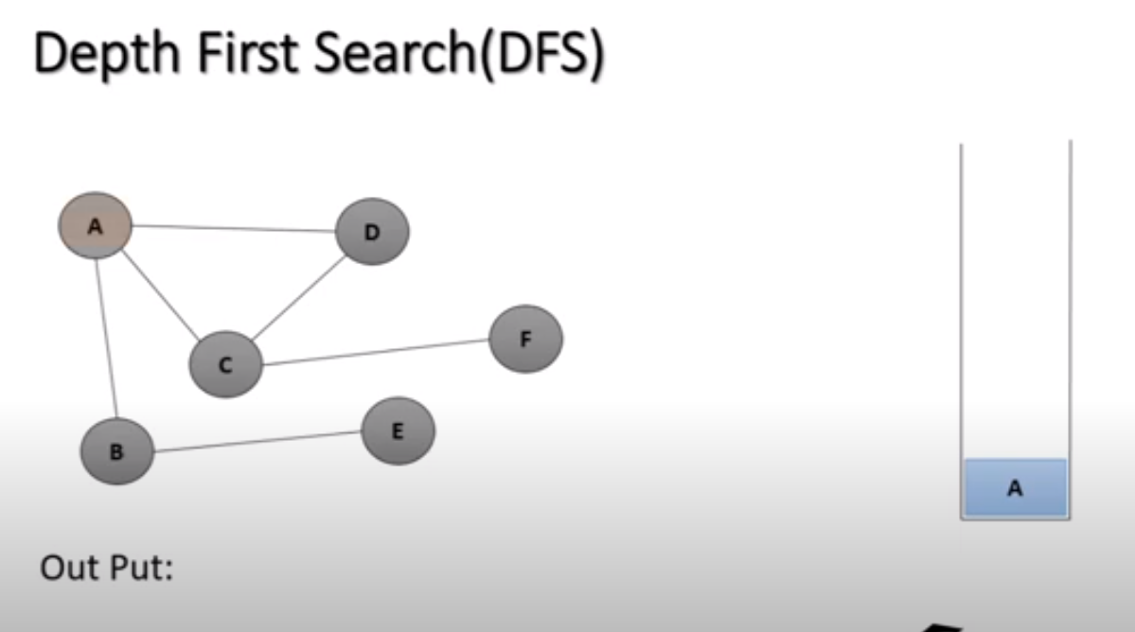

Slide 4
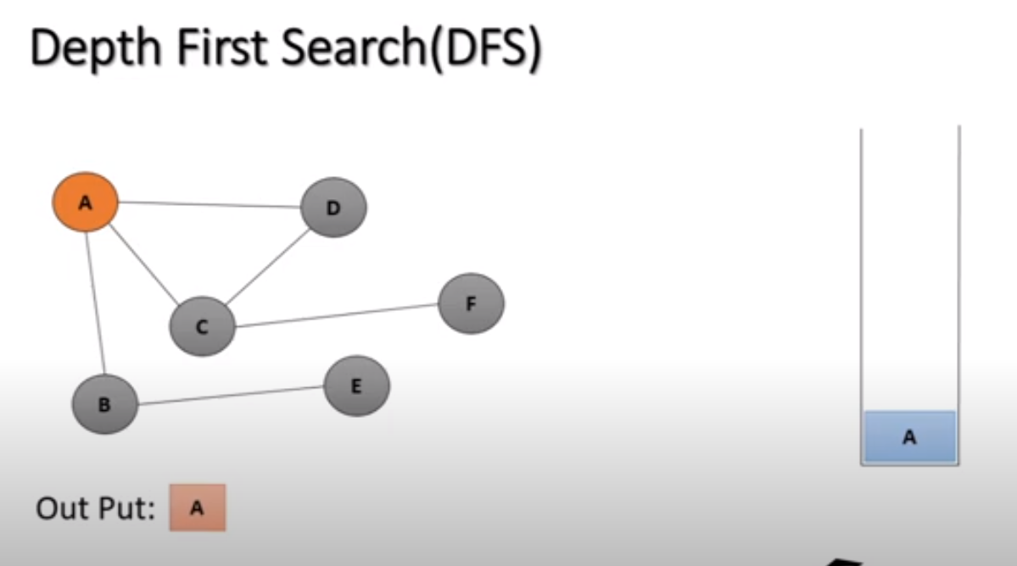

Slide 5
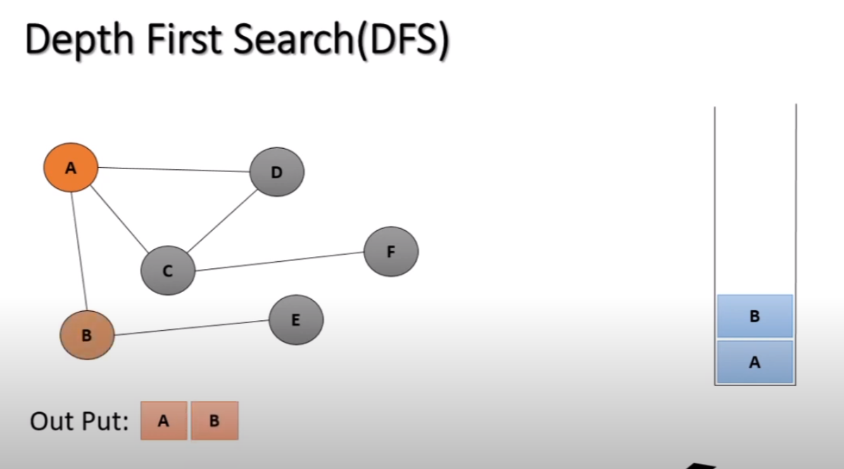

Slide 6
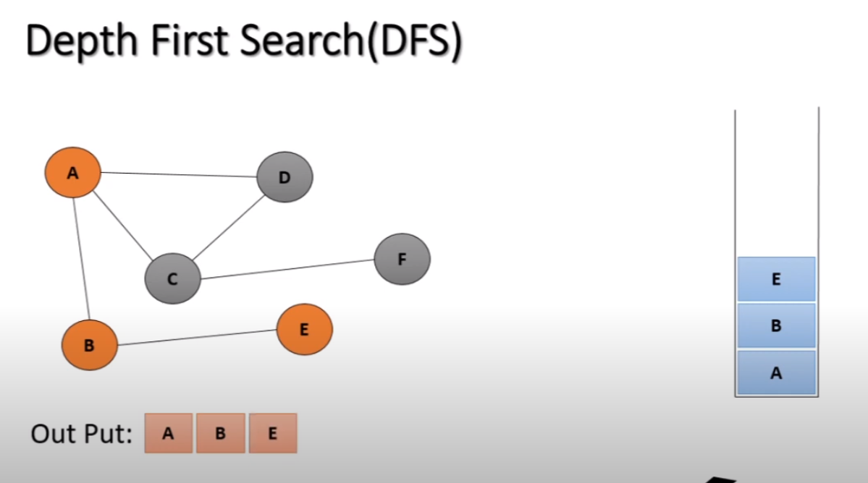

Slide 7
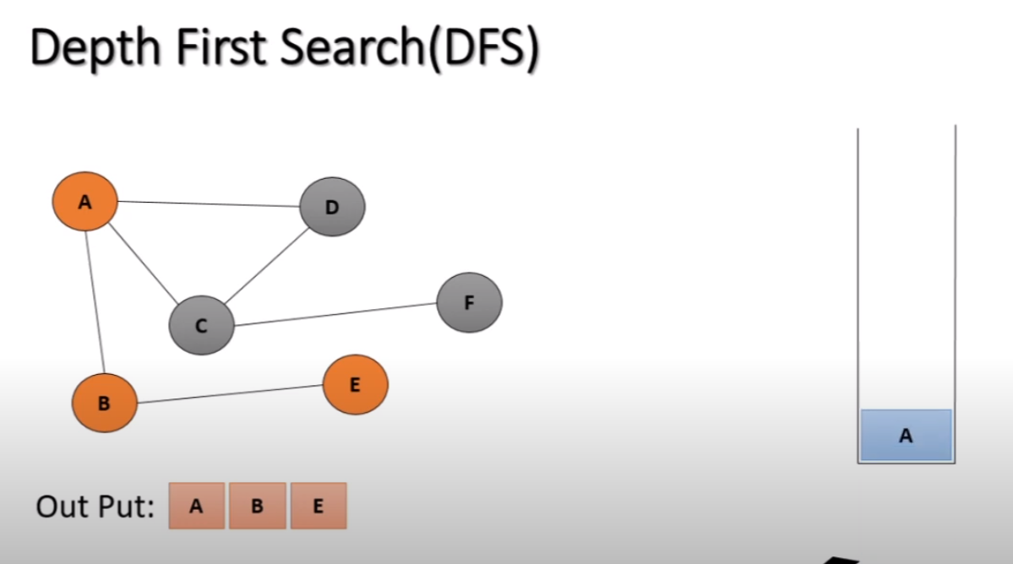

Slide 8
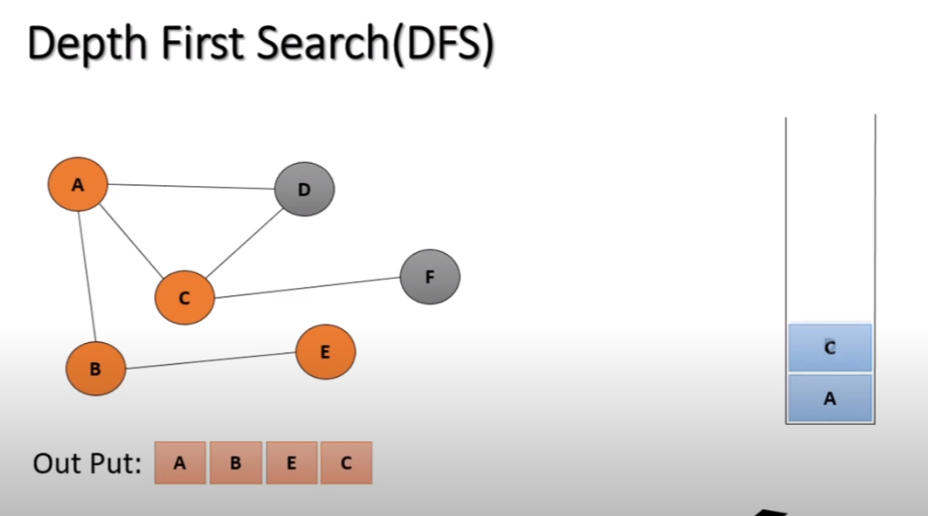

Slide 9
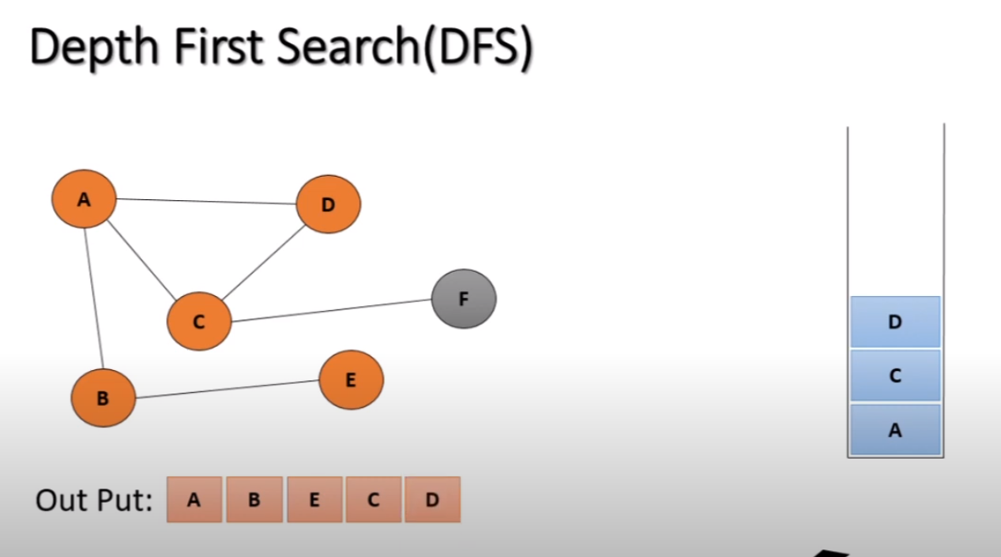

Slide 10
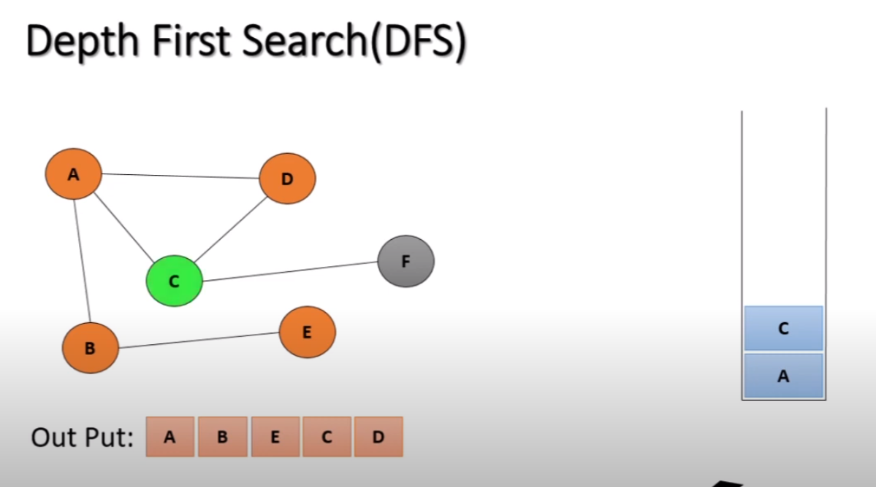

Slide 11
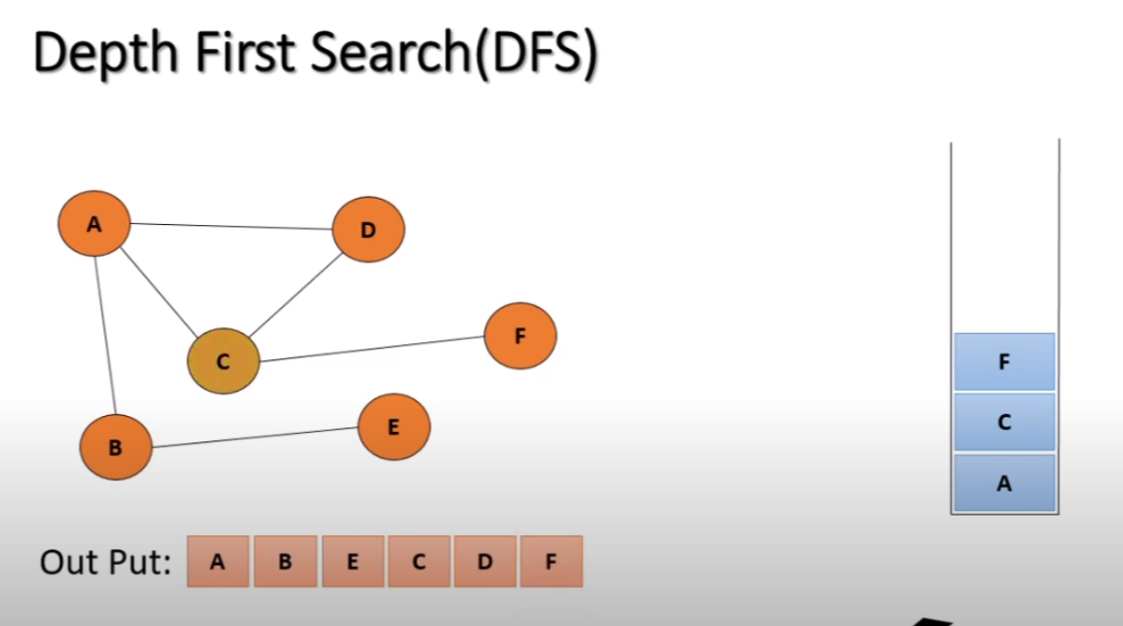

Slide 12
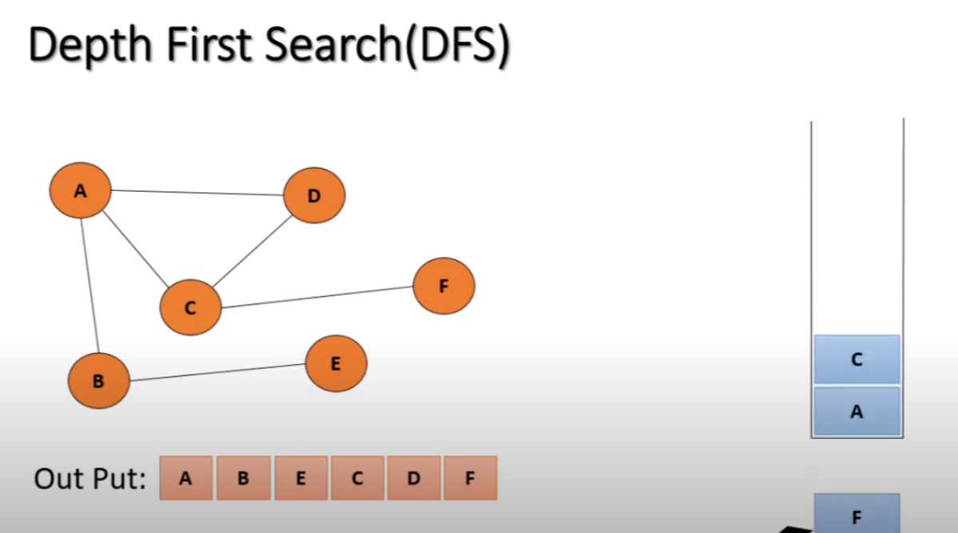

Slide 13
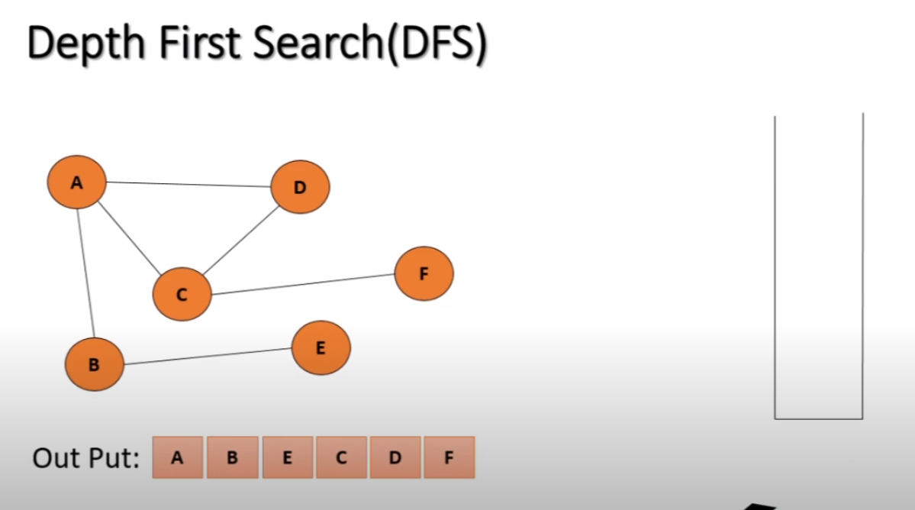

Slide 14
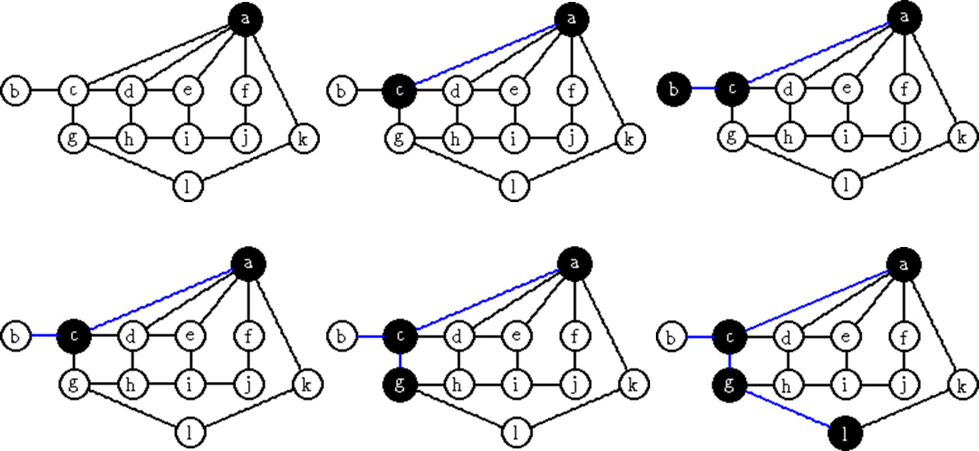
DFS Step (Example)

Slide 15
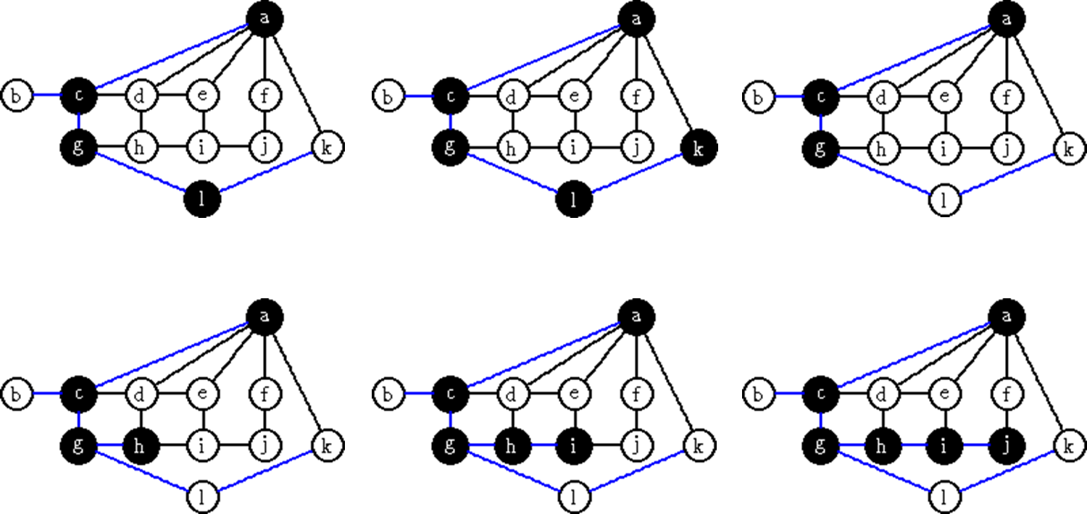

Slide 16
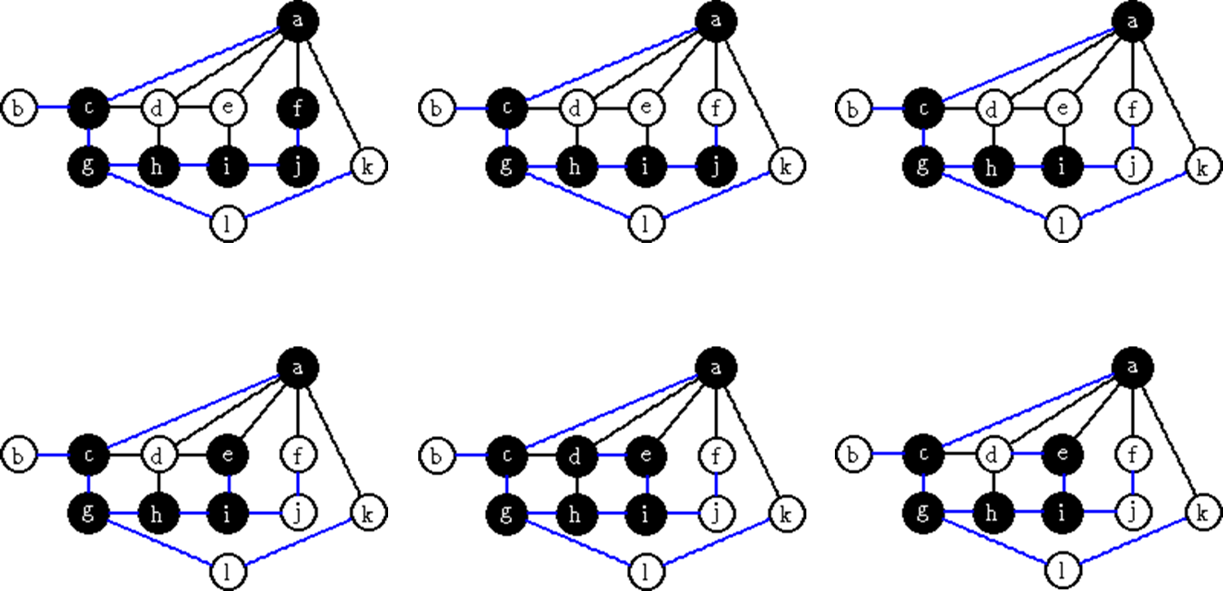

Slide 17
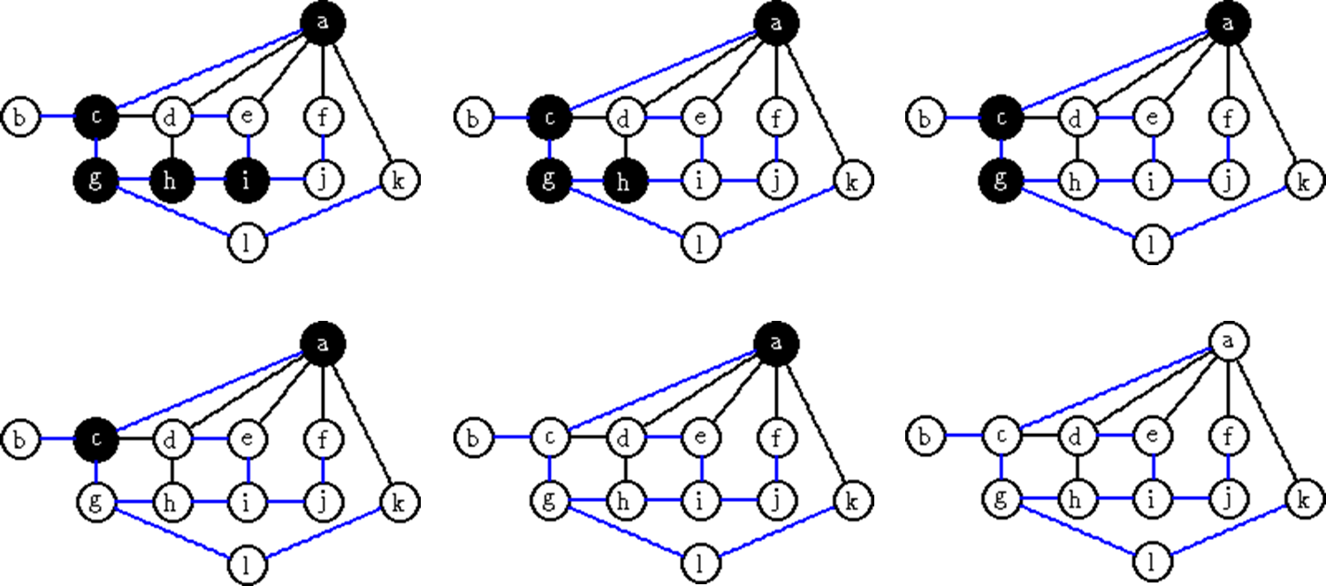

Slide 18
Depth First Tree
The tree constructed when a DFS is done

Slide 19

Real Life Example of DFS
There are a large number of applications which use depth first search algorithm.
Depth-first search is used in topological sorting, scheduling problems, cycle detection in graphs, and solving puzzles with only one solution, such as a maze or a sudoku puzzle.

Slide 20
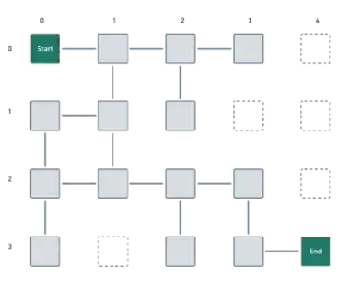
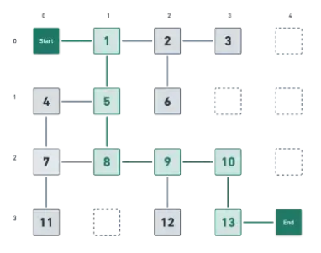

Slide 21
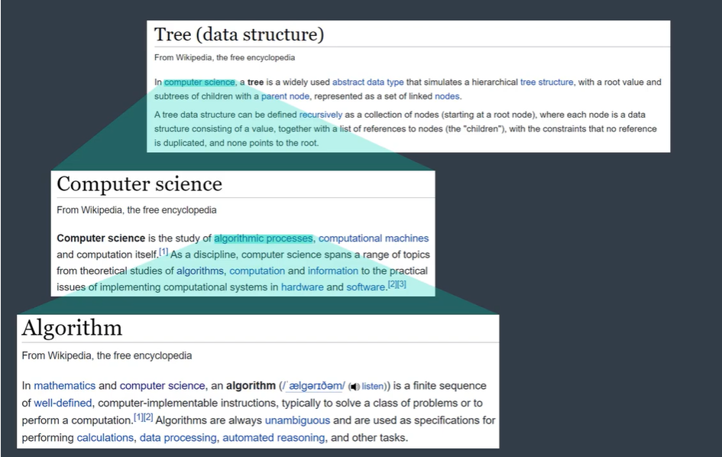
Reading a Wikipedia article
Once, we start reading an article at Wikipedia, we may encounter some highlighted keywords in the article.
If we pause reading the article and go on to read about that keyword, and while reading about that keyword it may also mention some other keywords, reading about that too at the very moment represents the technique of DFS traversal through those.

Slide 22
